Slide 1



How to Publish a Book on Amazon KDP
Step-by-Step Guide for Self-Publishing Success
Whitney Williams | Workshop Edition

Slide 2
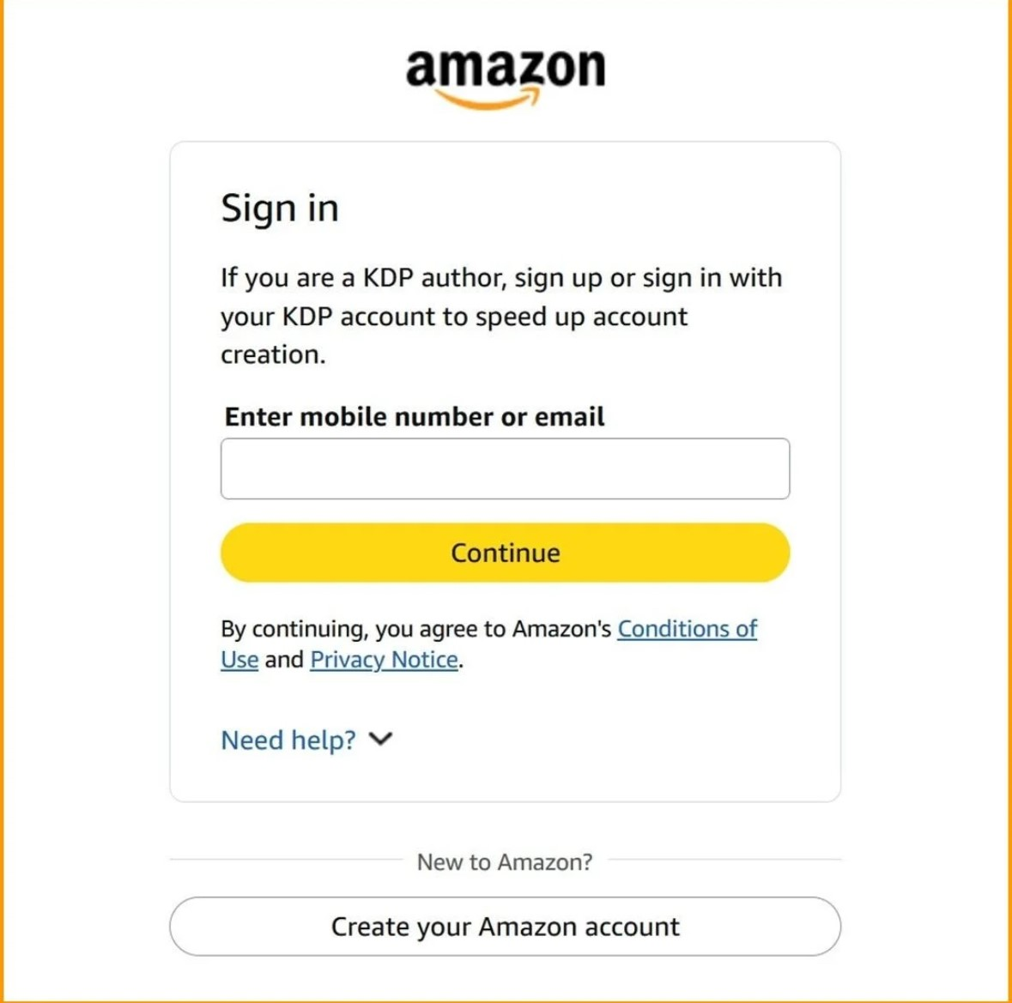
Step 1: Create or Log Into KDP Account
Go to kdp.amazon.com
  Sign in with Amazon account
  Complete tax + payment info

Slide 3
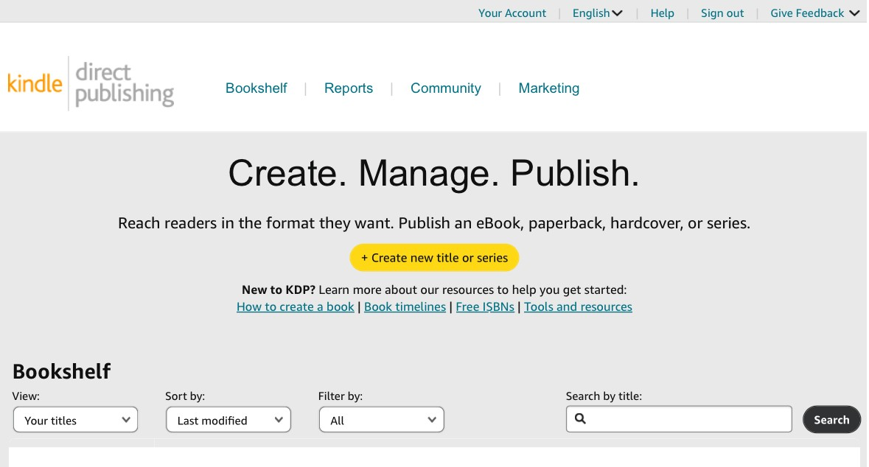
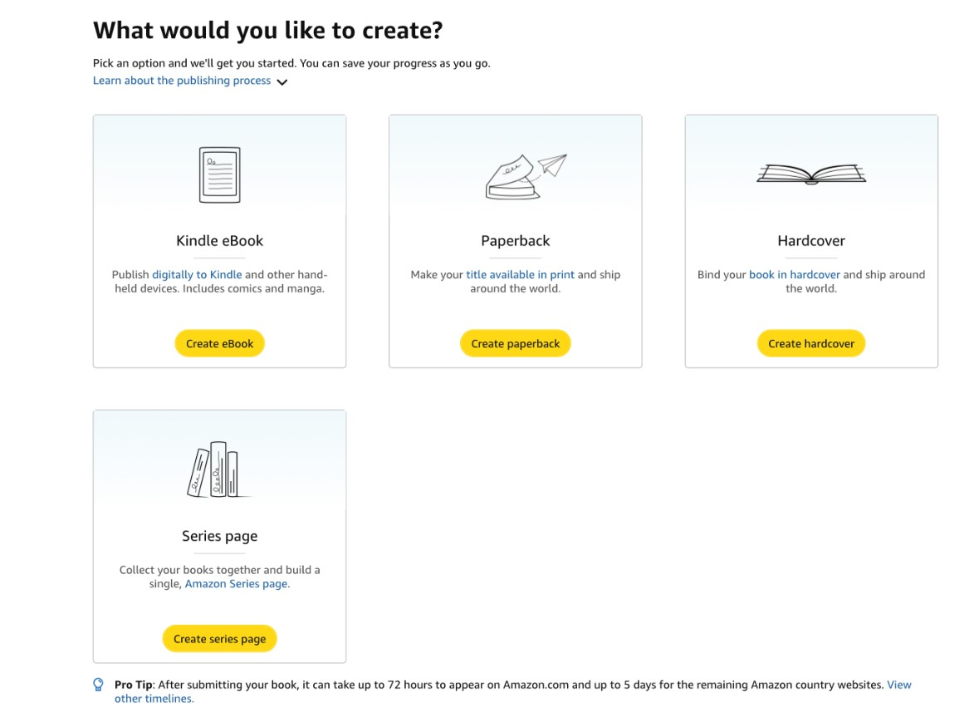
Step 2: Click 'Create' on Bookshelf
Choose: Kindle eBook, Paperback, or Hardcover
  Opens 3-step publishing process

Slide 4
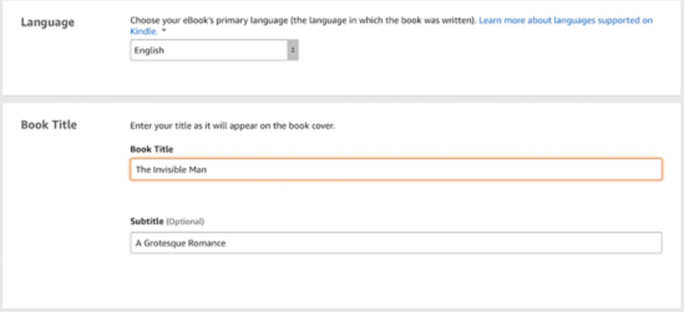
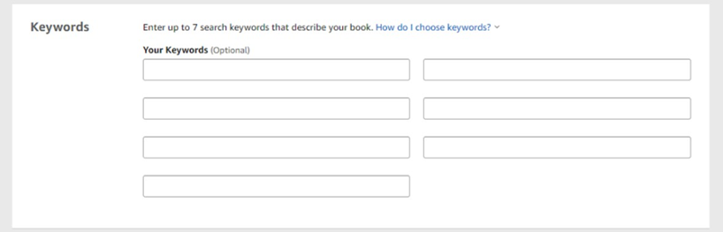

Step 3: Enter Book Details
Add Title + Subtitle
  Add Author Name
  Write Description
  Enter 7 Keywords
  Select Categories

Slide 5
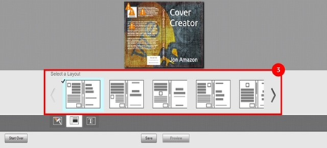
Step 4: Upload Manuscript & Cover
Upload interior file (PDF for paperback)
  Upload full cover file
  Use Print Previewer to check formatting

Slide 6
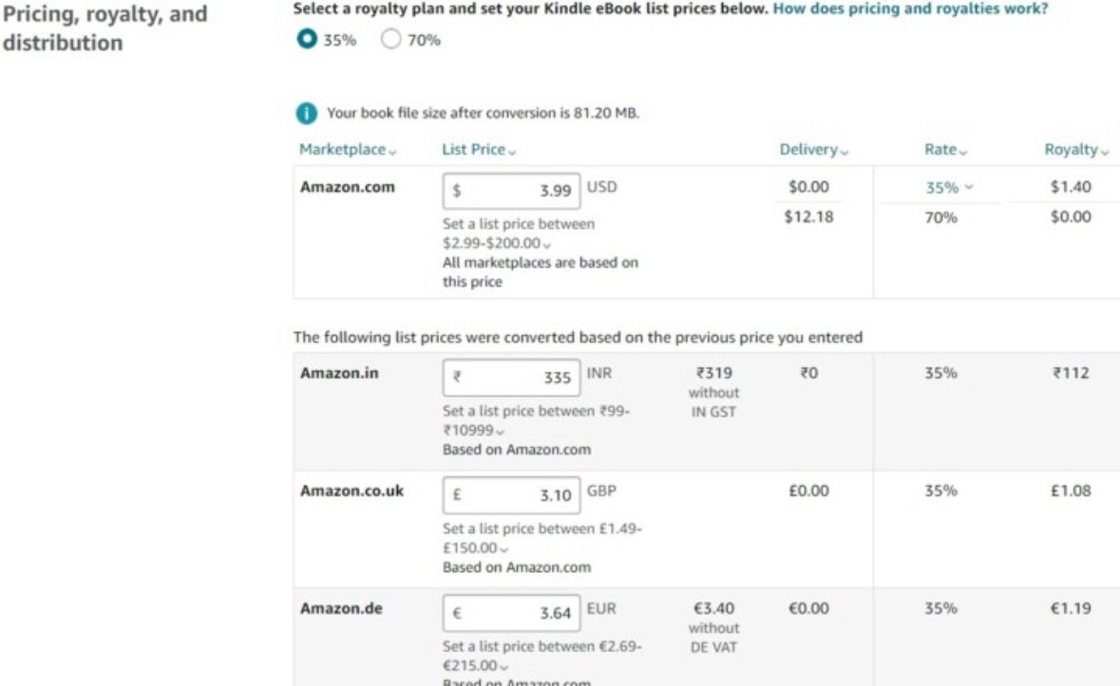
Step 5: Set Pricing & Royalties
Choose royalty option (35% or 70%)
  Select territories
  Set list price
  Review royalty calculator

Slide 7
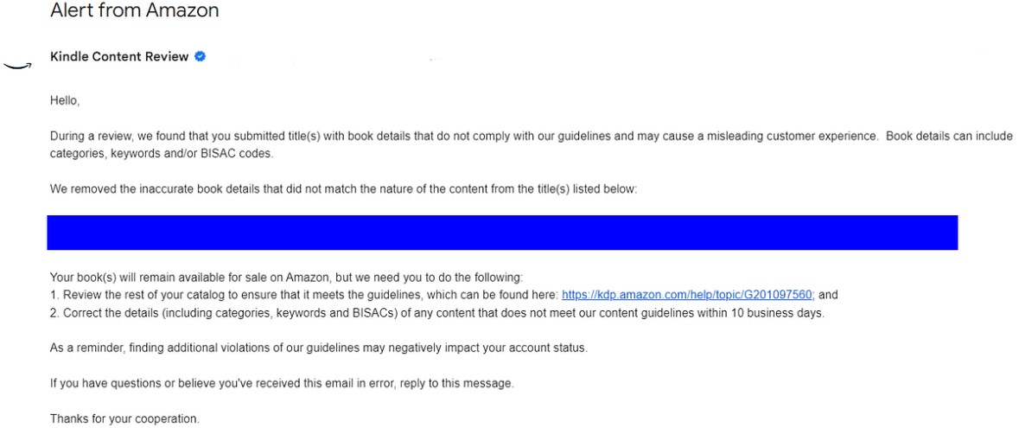
Step 6: Publish Your Book
Click 'Publish Your Book'
  Review takes 24–72 hours
  Status changes from Draft → Live
  Check email for and errors needing fixed

Slide 8
After Publishing
Order author copy
  Share Amazon link
  Collect reviews
  Add to website + social media
  Run ads (optional)

Slide 9
Congratulations you are now a published author!!
For other free resources, events, & books, and more, subscribe to Whitney Williams:
WhitneyWilliamsWrites.net

